Slide 1

Planet Express

Slide 2
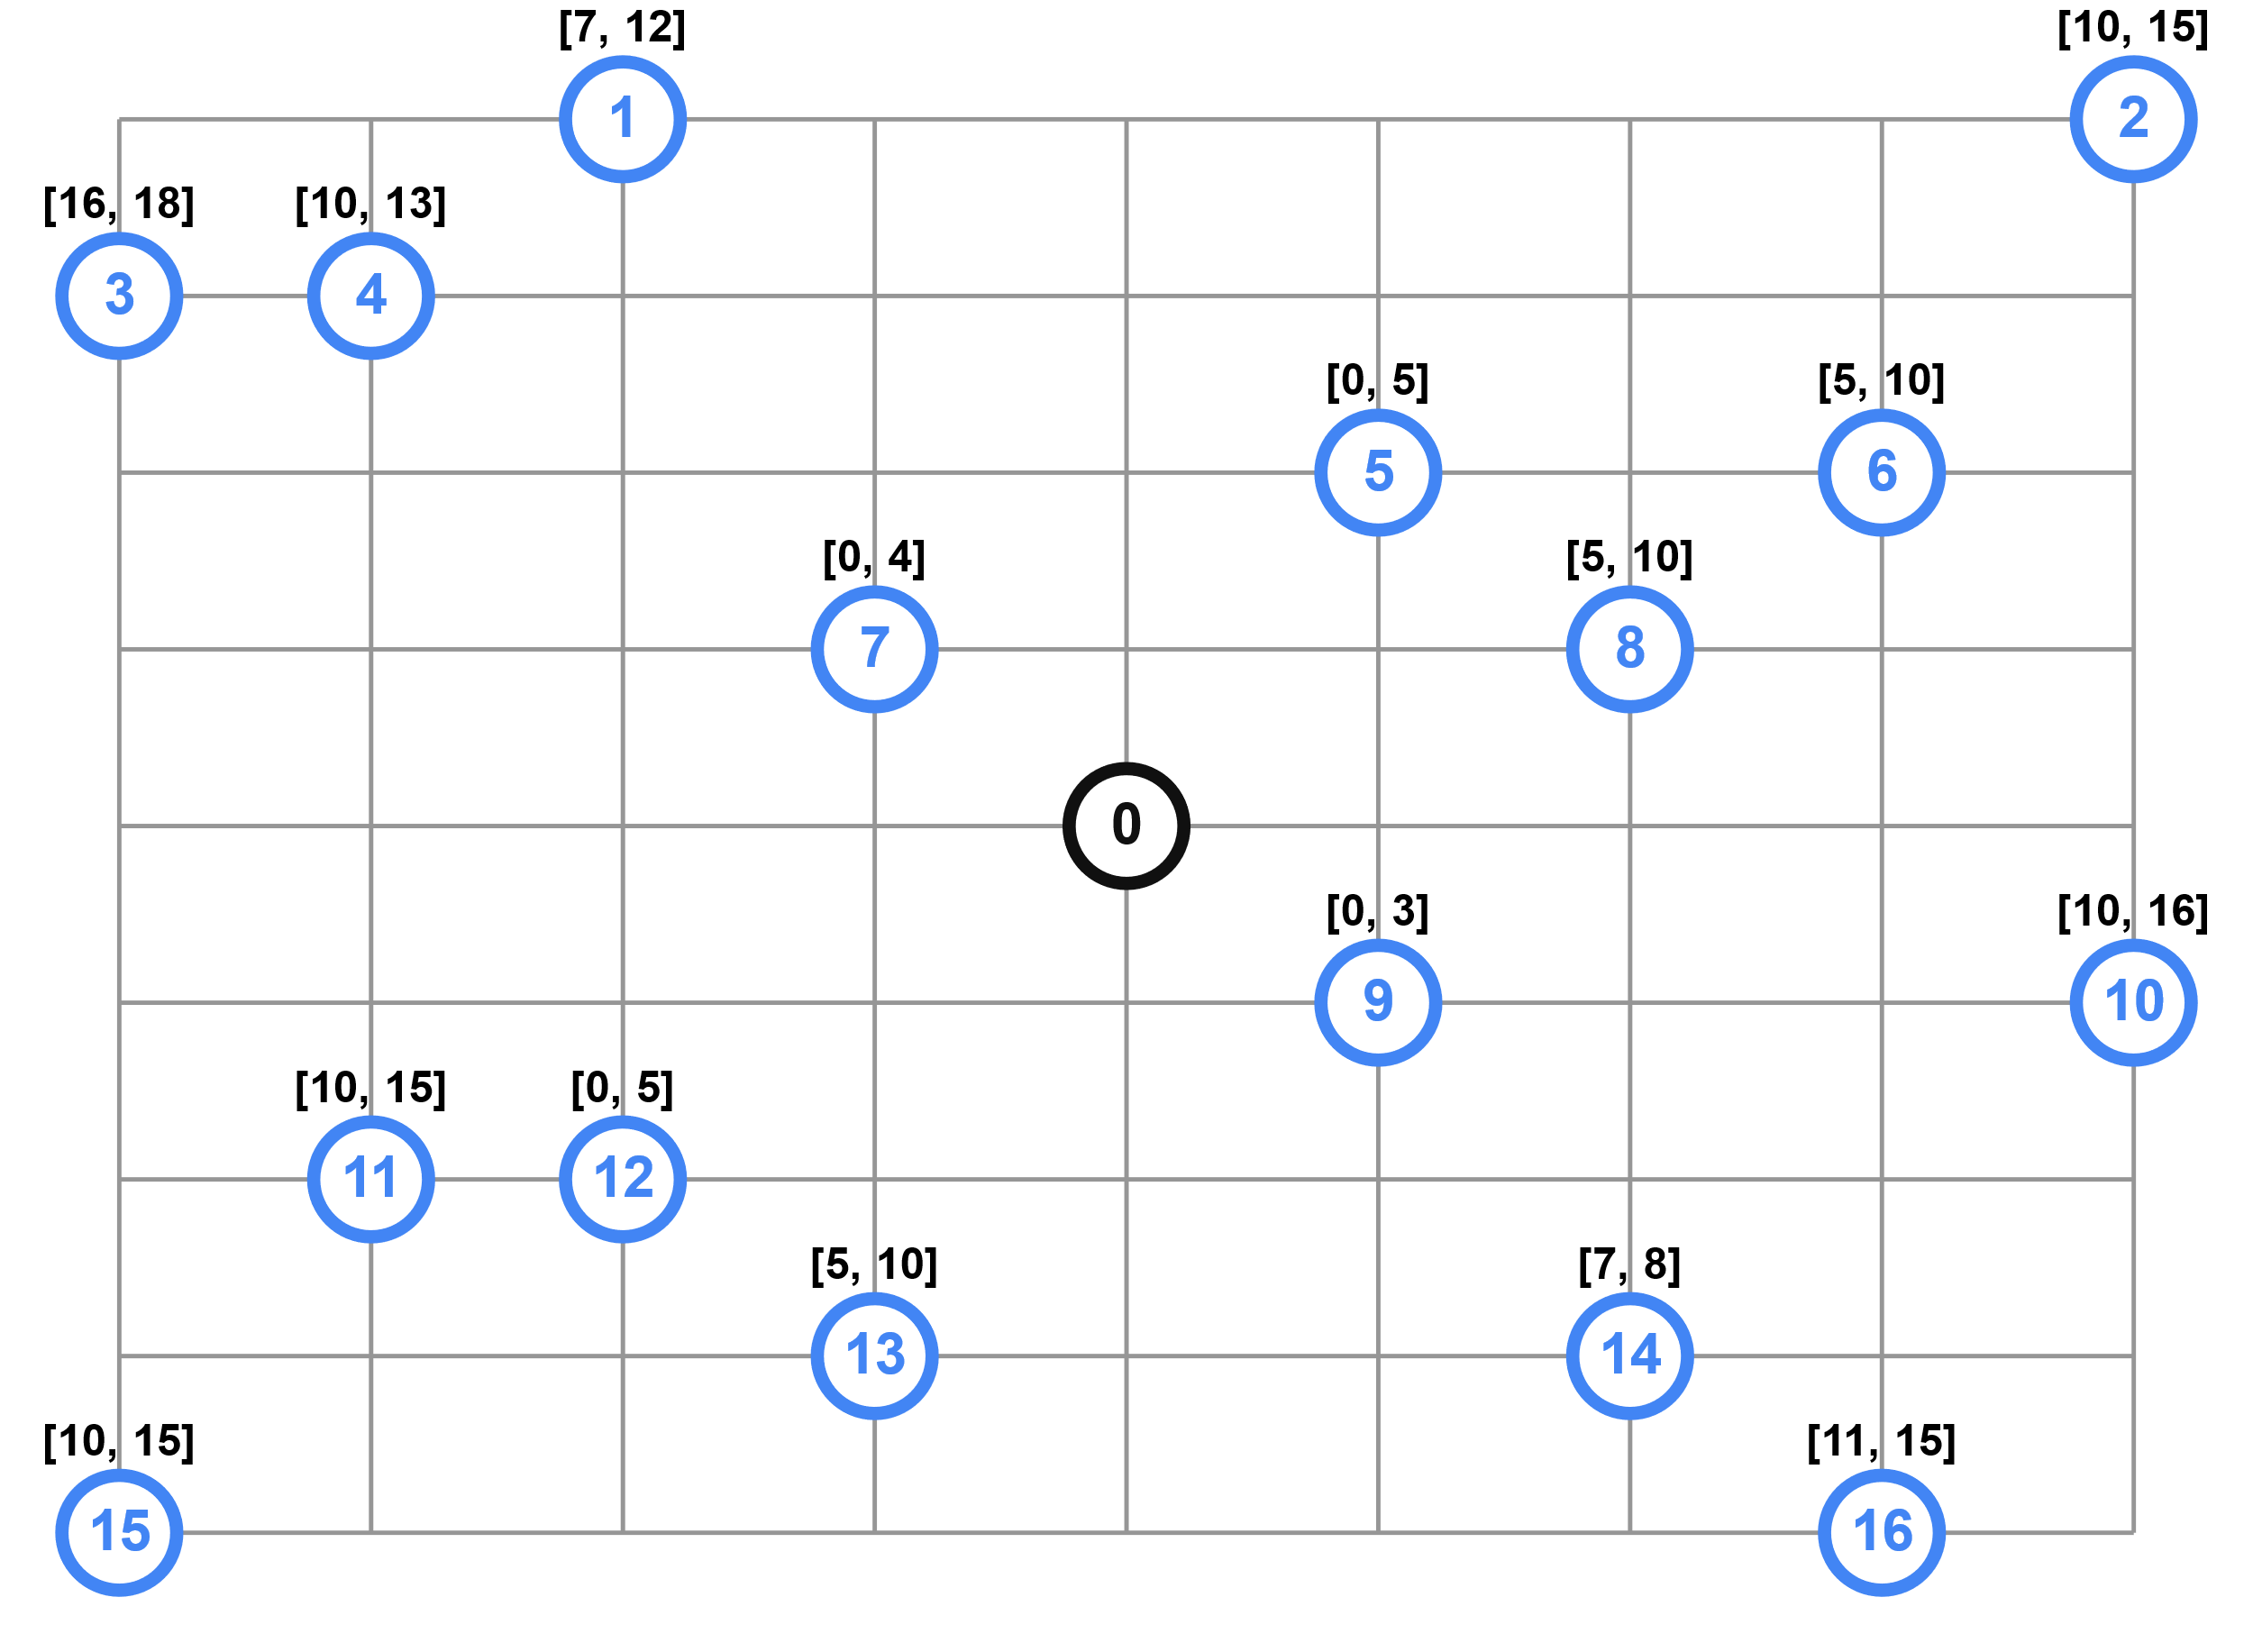
Vehicle Routing Problem with Time Windows

Slide 3



About our Stack

Slide 4
Used Solutions
Backend
Googlemaps
Numpy
Ortools
Frontend
React
React Router
Google Map React

Slide 5
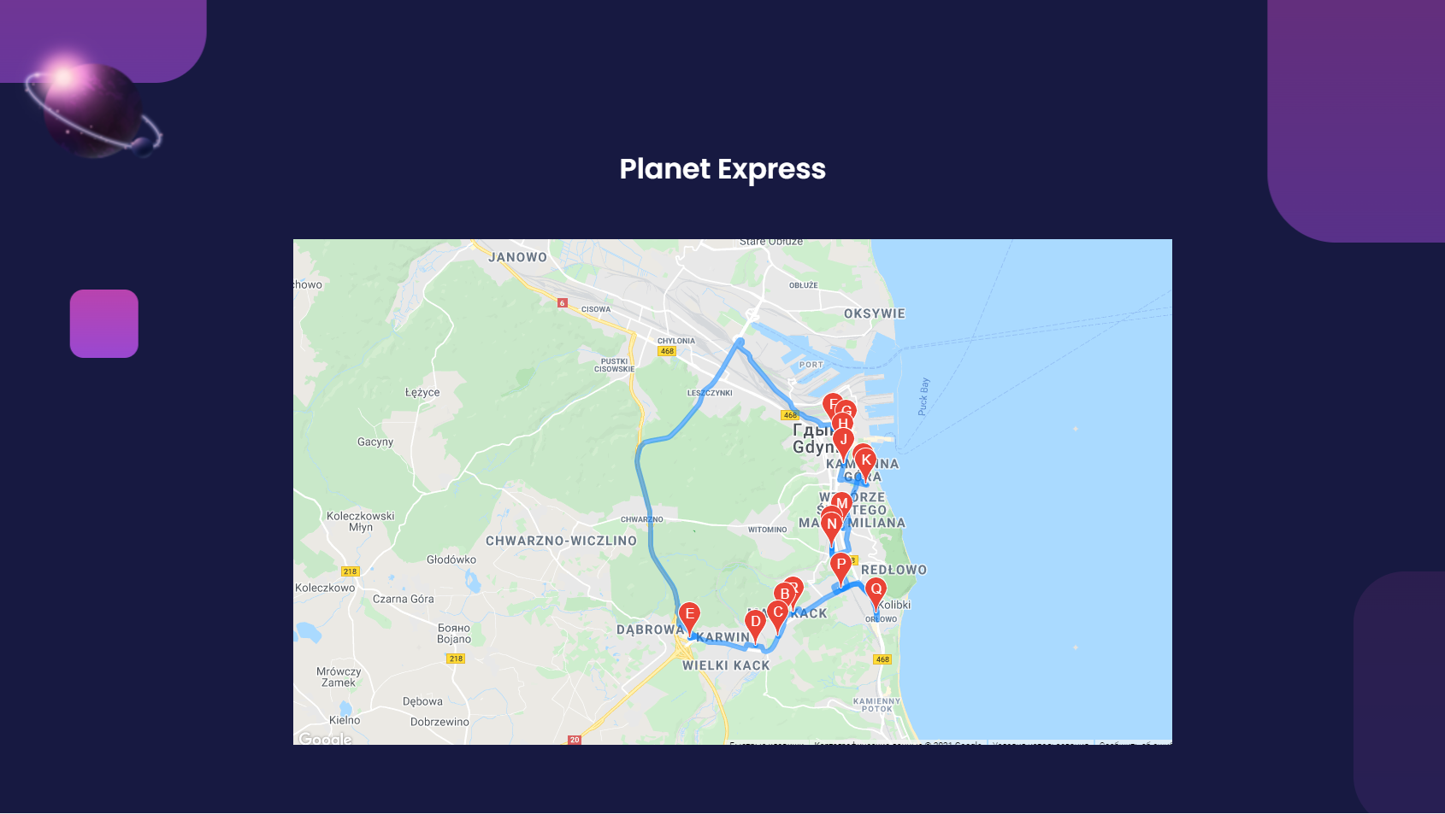
Planned User Interface
81-532, Witolda 17, Gdynia
81-532, Witolda 39A, Gdynia
81-532, Wielkoplska 260, Gdynia
81-587, Korzenna 16A, Gdynia
81-578, Wiczlinska 4, Gdynia
81-356, Starowiejska 40C, Gdynia
81-366, 10 Lutego 7, Gdynia
81-395, A. Abrahama 46 A-B, Gdynia
81-389, Świętojańska 75, Gdynia
81-389, Swietojanska 75

Slide 6
Planned Extension
Ability to provide locations using frontend
More complex input data validation
Path calculation based on the different
Vehicle types

